Slide 1
Login Authentication Using Active Directory
Recommended
Admin Console Login (UI)
Active Directory
Admin User Management (DB)
1
Send User Login Request to AD API
(User Id Password)
2
Validate / Authenticate User in AD
Authorization Failed – AD
Fail
3
3.1
Success
AD Authorization OK
3
Send User Login Request to Admin Console User Management
Validate / Authenticate in Centralized Database.
Check Role
Authorization Failed – User Management
Fail
4
4.1
Success
6
UM Authorization OK
5
Generate Login Ticket
Send User Authenticated Response to Admin Console with Token

Slide 2
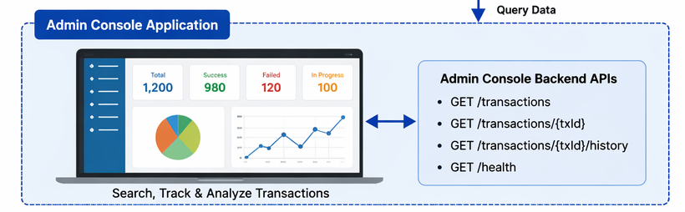
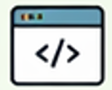

Admin Console System Desing & Integration Windchill
Integration Flow
PDM
Request
SAP PI (Middleware)
Request
ENOVIA
Response
Response
1. Part Create Action
2. Forward Req to Enovia
3. Process, Validate & Create Part
API Auth:
Static API Key (Base64 Encrypted)
Send Transaction Events (API Call : fire-and-forget)
REQUEST_INIT
RESPONSE_RECEVED_AT_PDM
2. ENOVIA_REQUEST_RECEIVED
ENOVIA_REPONSE_SENT
Central Logging Service
Spring Boot API Layer
Non-Blocking API Endpoints
PostgreSQL DB
Transactions
transaction_id
part_number
status
API Auth:
JWT
POST /api/transaction/status

Slide 3
Admin Console System Desing & Integration SolidWorks
Integration Flow
PDM (Client)
Request
PDM (Middleware)
Request
SAP PI (Middleware)
Request
ENOVIA
Response
Response
Response
1. Part Create Action
2. Forward Req to Enovia
3. Process, Validate & Create Part
API Auth:
Static API Key (Base64 Encrypted)
Send Transaction Events (API Call : fire-and-forget)
REQUEST_INIT
RESPONSE_RECEVED_AT_PDM
2. ENOVIA_REQUEST_RECEIVED
ENOVIA_REPONSE_SENT
Central Logging Service
Spring Boot API Layer
Non-Blocking API Endpoints
PostgreSQL DB
Transactions
transaction_id
part_number
status
API Auth:
JWT
POST /api/transaction/status

